Slide 1
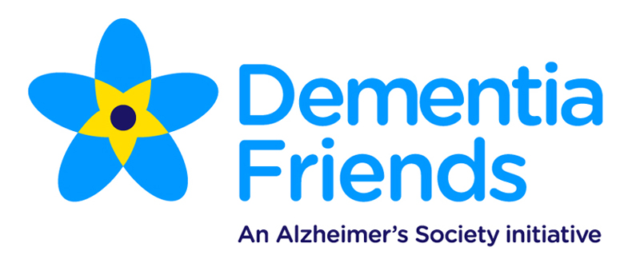
Dementia Friends

Slide 2
1
This lesson will help learners to understand:
what memory is and how it works
what the brain controls
what is dementia and how it is
related to memory?

Slide 3
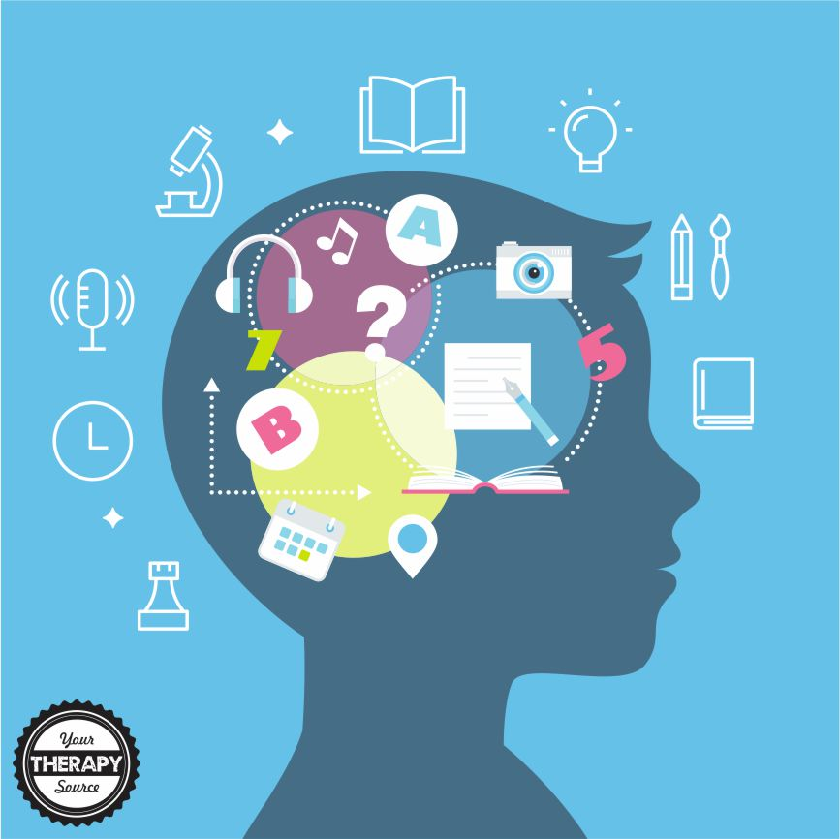
What is My Memory
Collect
Keep/Store
Retrieve

Slide 5
The hippocampus is a small organ located within the brain's medial temporal lobe and forms an important part of the limbic system, the region that regulates emotions. The hippocampus is associated mainly with memory, in particular long-term memory. The organ also plays an important role in spatial navigation.

Slide 6
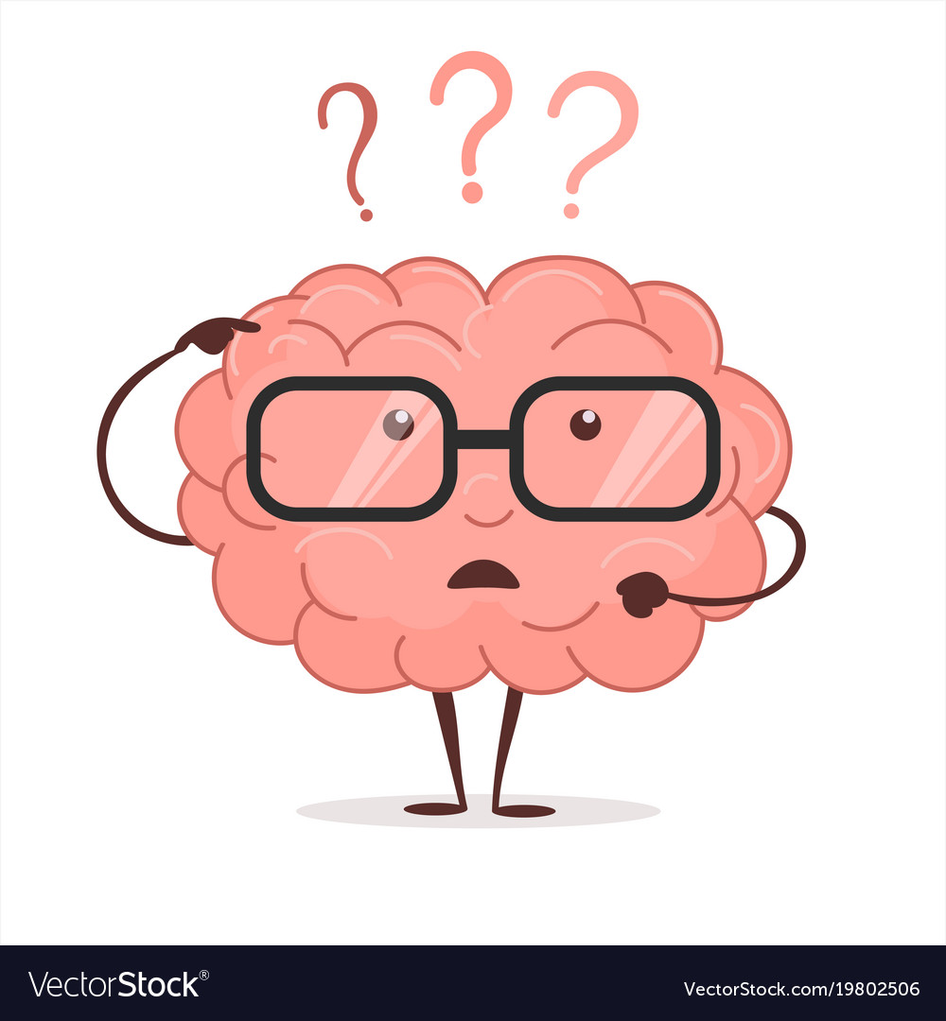
How you use your brain

Slide 7
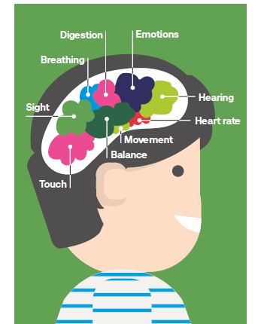
Have you Used Your Brain Today?

Slide 8
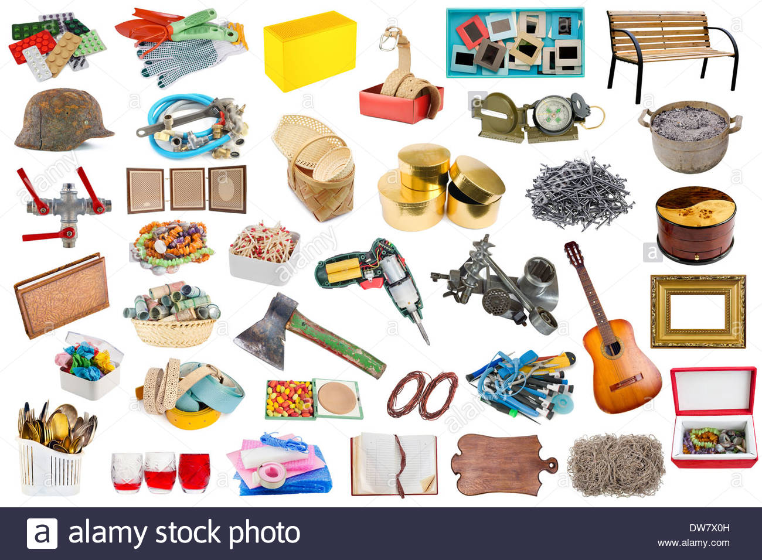
Object Lesson

Slide 9
DISCUSSION
Q: How did you do this? Did you have any good
strategies to help you remember the objects?
Q: What was difficult?
Q: If you did this again would you do it differently?
Q: How did this make you feel?
Q: What does our memory do? How does it work?
Q: How does our memory help us in our lives?

Slide 10
Further discussion topics:
Q: What is memory?
Q: How can you improve your memory?
Q: What strategies help you to remember?
Q: What games can you play to help you
remember better?
Q: What happens to your memory when
you get worried?
15 minutes

Slide 11
Memory Loss

Slide 12
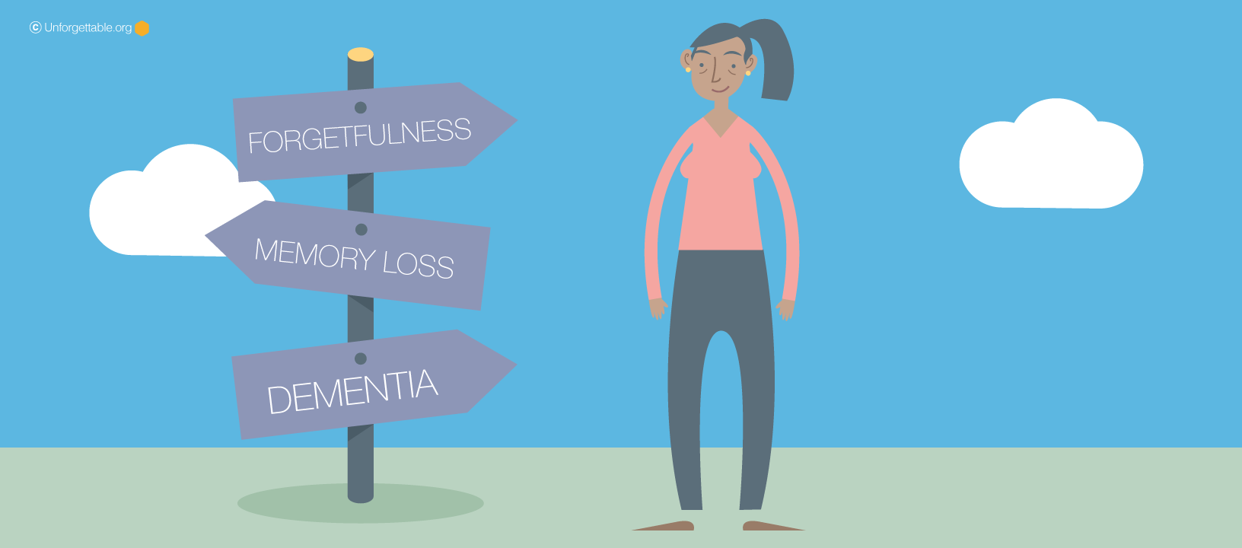
My Memory

Slide 13
Lets Go Shopping
Ask the class to sit in a circle. Start with the first learner and ask them to say: ‘I am going shopping and I am going to buy…’.
Each learner should give an item beginning with the next letter of the alphabet
As you go around the circle, each learner must repeat the phrase as well as each item (in alphabetical order); they must then add their item to the end of the list.

Slide 14
Making The Connection
Make a list of things you have to do on a morning when you get dressed to leave the house.
The String Theory!!!!

Slide 15
What is Dementia?
Dementia describes a set of symptoms that may include memory loss and difficulties with movement, problem-solving or communication.
Dementia is caused when the brain is damaged by diseases such as Alzheimer’s disease or a series of strokes.
It is progressive, which means the symptoms will get worse over time.
Although dementia mainly affects older people, it is not a natural part of ageing.
There are 850,000 people living with dementia in
the UK, with this figure predicted to reach 2 million by 2051 if no action is taken.

Slide 16
2
understand how dementia affects
the whole family
appreciate that people with
dementia often require support
from carers
understand what a carer is and
explore the role of carers

Slide 17
3
This lesson will help learners to:
understand the types of difficulties
people with dementia may experience
identify ways in which communities
can support people

